Slide 1

ESSENTIAL OILS
CHEM SEC 204TH
Department of Chemistry
Government College
Paonta Sahib (HP)

Slide 2
Topics
ROSE OIL
2-PHENYL ETHYL ALCOHOL
Chemical constituents
Sources
Uses

Slide 3
ROSE OIL
It is also known as rose otter or Attar of rose or Rose essence. It is an essential oil extracted from the plants of various types of roses. Rose Otto is extracted through steam distillation, while rose absolutes are obtained through solvent extraction or super critical carbon dioxide extraction. The rose absolutes are more commonly used in perfumery.

Slide 4
Chemical Composition:
The key compounds i.e. β- Damascenone, β-Damascone, β-ionone and rose oxide contributes about 90% of fragrance to rose oil. The other common compounds present in rose oil are, Citronellol, geraniol, nerol, linalool, phenylethyl alcohol, eugenol, methyl eugenol, rose oxide, benzaldehyde, α-pinene, β-pinene etc.
Sources:
The rose oil is extracted from the petal, of rose. The major species of rose are cultivated for the production of rose oil. These are
Rosa damascena (Damask rose): It is widely grown in India, Russia, China, Turkty Bulgaria, Syria, and Pakistan.
Rosa centifolia (Cabbage rose): It is more commonly grown in Egypt, France and Morocco.

Slide 5
USES
The finest and most important use of rose oil is in perfume industry where they are used for making the most widely used perfumes all over the world.
They are also used in creams, face washes, nail polishes, hair sprays etc.
Many studies have found that rose oil improves mood, enhances sleep and boosts energy level in the body.
Rose oil boosts self-esteem, confidence and mental strength as it acts as antidepressant. Patients with depression are advised to take regular dose of this oil.
Rose oil strengthens gums and hair roots.
Rose oil acts as good bactericide. It can be used in the treatment of typhoid, diarrhea, cholera, food poisoning, etc

Slide 6
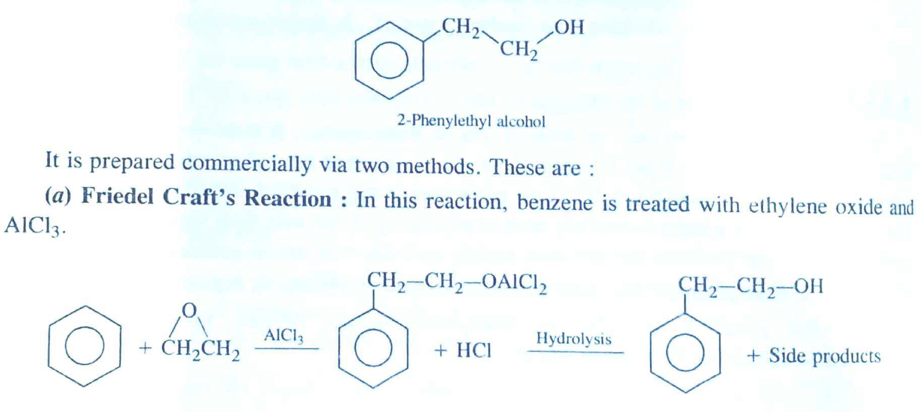
2-PHENYL ETHYL ALCOHOL
It is an organic compound, liquid at room temperature, slightly soluble in water and fully soluble in organic solvents. It occurs widely in nature in most of the essential oils like rose oil. It has a pleasant floral odour.
Chemical formula and preparation:
It is an organic compound having a phenylethyI group (C₆H₅-CH₂-CH₂) attached to -OH group that is why, it is named so.

Slide 7
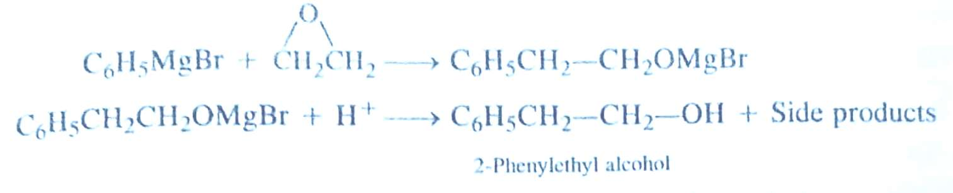
It can be prepared commercially via two methods
(a) Friedel Craft's Reaction: In this reaction, benzene is treated with ethylene oxide and AlC1₃.
(b) Using Grignard Reaction: In this reaction, phenyl magnesium bromide is treated with ethylene oxide to form an addition product which upon treatment with acid gives 2-Phenylethyl alcohol.

Slide 8
Natural sources:
The natural sources of 2-Phenylethyl alcohol are extracts of rose, carnation, orange blossom. Ylang-ylang, geranium (herbs) and champaca. It is also produced by fungus Candida albicans as an autoantibiotic.
USES:
It is used as a common ingredient in flavours and perfumery, particularly when odour of rose is desired.
It is used as an additive to cigarettes.
It is used as a preservative in soap due to its stability in basic conditions.
It is used as an antimicrobial and antibiotic substance.

Slide 9


